Slide 1
A green social media platform (Part 1)
By Filip Rehburg

Slide 2

What will the interface be about?
Social media for eco-conscious users
Share, rate & read blog posts
Connect with users (friends)
Find local, green stores
Organize & attend events

Slide 3
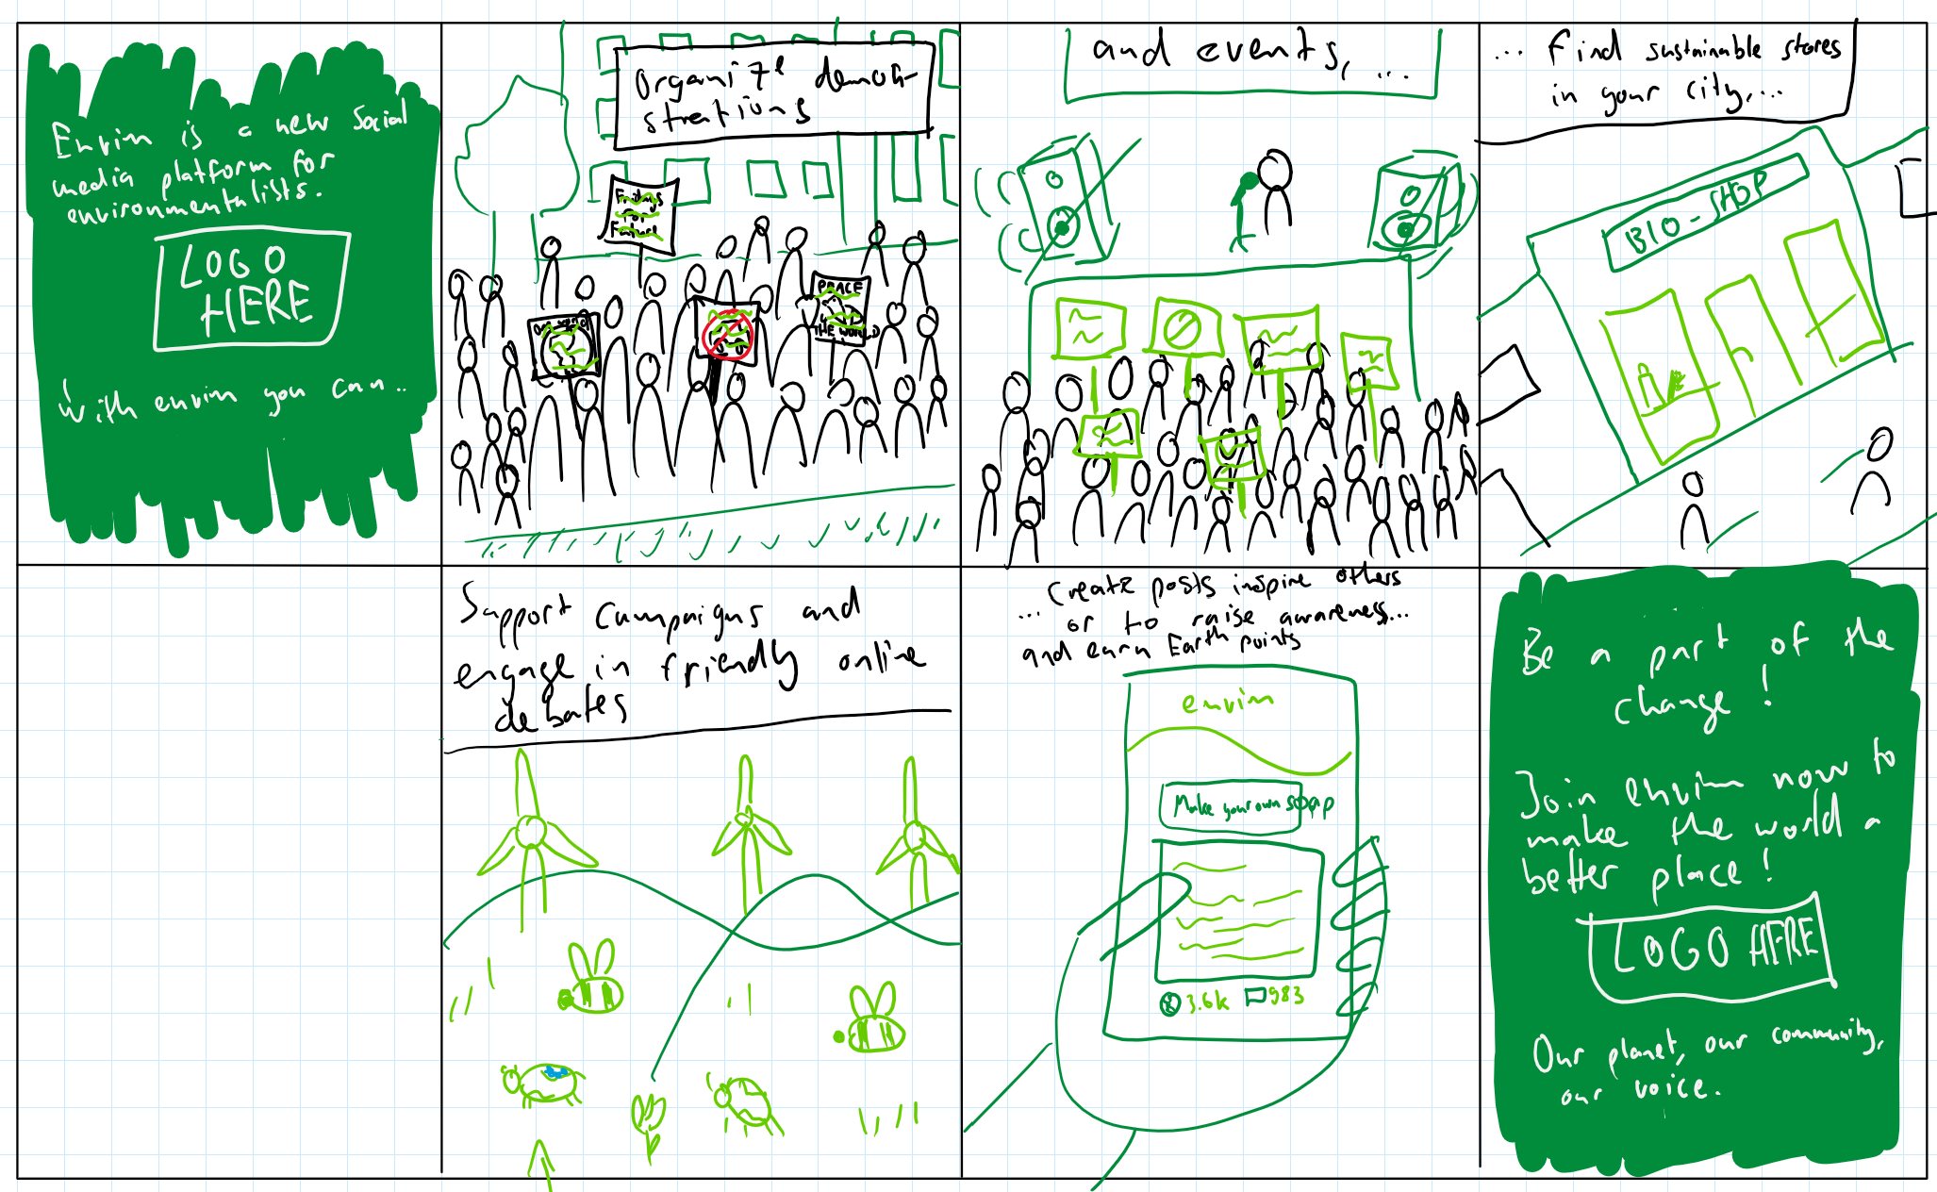
What will the interface be about?

Slide 4
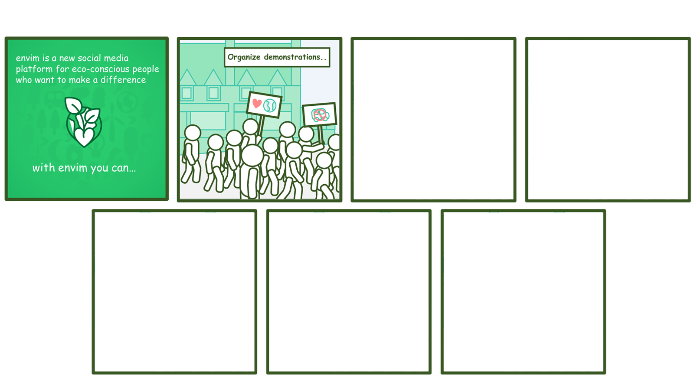
What will the interface be about?

Slide 5
What problems will it solve?
Scattered over other social media
Hard to
Find information
Chat with like-minded users
Find out about local stores
Find out about events
No Central platform for environmentalist

Slide 6

What is new about it in comparison to similar products?
Unique combination of best features
Blog posts (no length limitation)
Like button & karma: “Earth points”
No dislikes → prevent negativity
Find out about local events & stores

Slide 7
Online questionnaire
Questions about:
Use of social media → environmentalism
Importance of features:
Connecting to other users
Receiving information
Sharing opinions & information
Events
Shops
Link: https://forms.gle/7v5zLXXZxu3H5DZN9

Slide 8
Outcomes online questionnaire

Slide 9
Conclusion

Slide 10
Thank you for listening!

